Slide 1
Introductory General Chemistry
Chemistry 3A
Experiment 2a
Atomic Masses
Mitch Halloran

Slide 2
Introduction
In this experiment, you will be calculating the average atomic mass of a fictional element called Fresnocitium which has three isotopes that are different colors: red, black, and white.

Slide 3


Facts To Know For This Lab
Matter is composed of atoms
The elements (in the Table) actually describe the properties of these atoms
Atomic structure shows a composition of
subatomic particles
  Protons: symbol p⁺
    Contained in the nucleus of the atom
    Has a positive charge (+1)
    Has a mass of 1 amu, slightly smaller than the neutron, 1800 times larger than the electron
    Number of protons (atomic number, Z) defines identity of element, its name and symbol
  Electrons: symbol e–
    Exist in orbitals outside of the atomic nucleus
    Has a negative charge (–1)
    Has a mass of 5.5 x 10⁻⁴ amu, slightly smaller than the neutron
  Neutrons: symbol n⁰
    Exist in nucleus alongside protons
    Has a zero electrostatic charge
    Has a mass of about 1 amu, slightly larger than protons

Slide 4
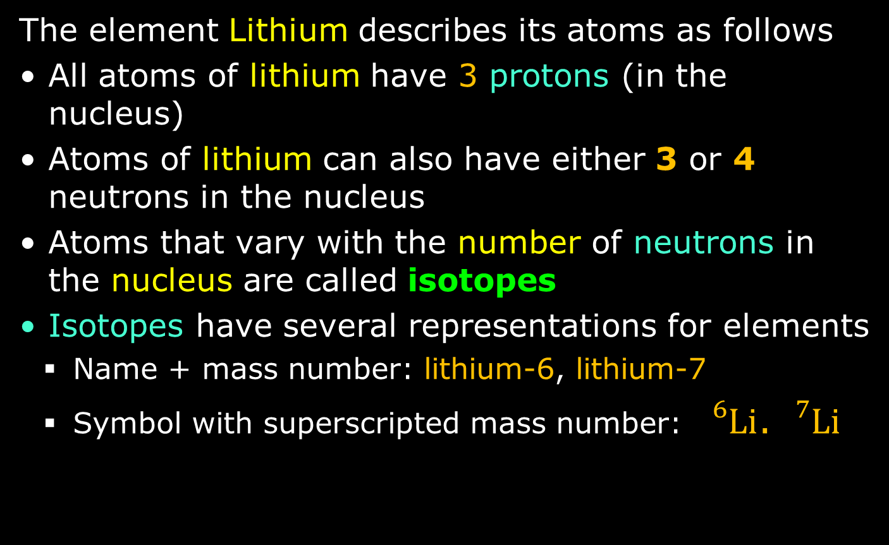
Background
The element Lithium describes its atoms as follows
All atoms of lithium have 3 protons (in the nucleus)
Atoms of lithium can also have either 3 or 4 neutrons in the nucleus
Atoms that vary with the number of neutrons in the nucleus are called isotopes
Isotopes have several representations for elements
  Name + mass number: lithium-6, lithium-7
  Symbol with superscripted mass number: ${}_{}^{6}{Li}$. ${}_{}^{7}{Li}$

Slide 5
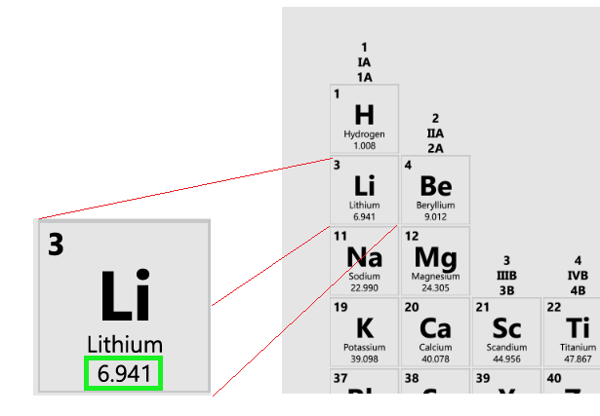
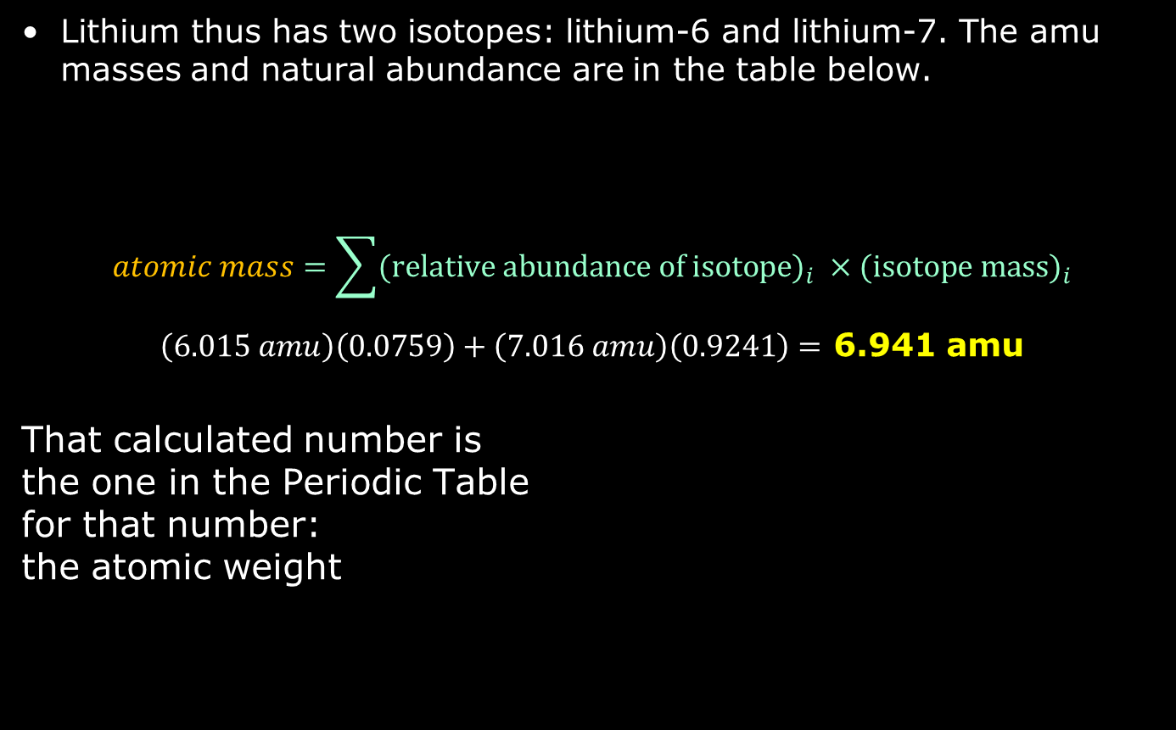
Background
Lithium thus has two isotopes: lithium-6 and lithium-7. The amu masses and natural abundance are in the table below.
$$atomic mass=\sum{{\text{(}\text{relative} \text{abundance} \text{of} \text{isotope}\text{)}}_{i} ×{\text{(}\text{isotope} \text{mass}\text{)}}_{i}}$$
$\left(6.015 amu\right)\left(0.0759\right)+\left(7.016 amu\right)\left(0.9241\right)=$ 6.941 amu
That calculated number is
the one in the Periodic Table
for that number:
the atomic weight
Isotope | Atomic Mass (amu) | Natural Abundance
Lithium-6 | 6.015 | 7.59%
Lithium-7 | 7.016 | 92.41%

Slide 6
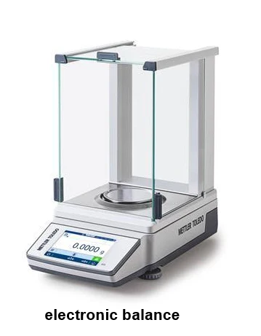
Equipment You Will Use

Slide 7
Procedure
Look at the Chem 3A lab manual (printed or online)
You are using the balances, so record quantities exactly as they should be recorded
Partners make their own measurements or measure together to verify the masses
Double-check masses when possible. That is repeat the measure a 2nd time: the value should be close. If not, consider instrument issues or not being careful in measuring.

Slide 8
Clean Up
Make sure the colored beads (“atoms”) are stored in the stock container

Slide 9
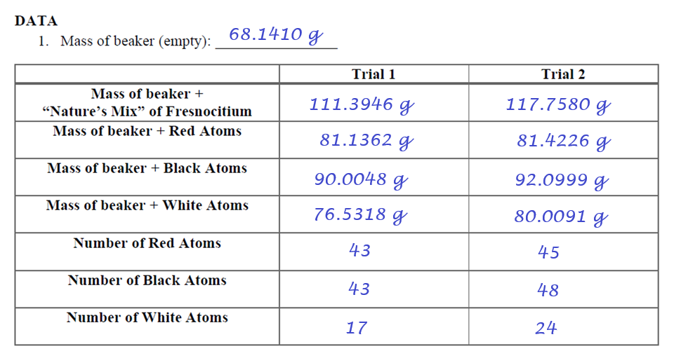
Example Data Analysis

Slide 10
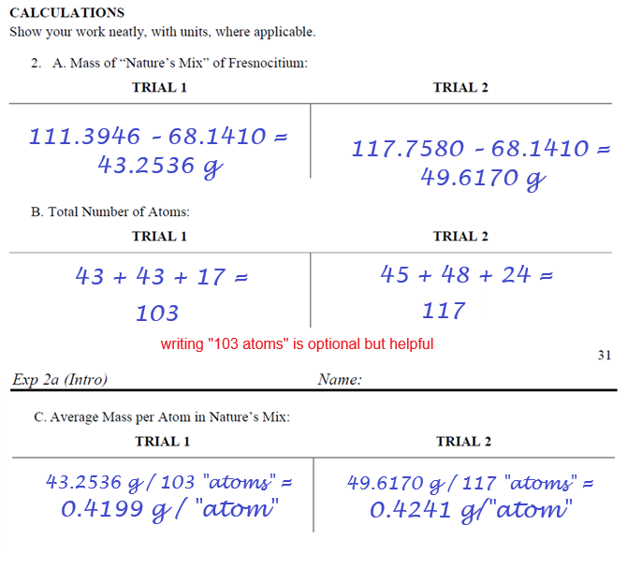
Example Data Analysis

Slide 11
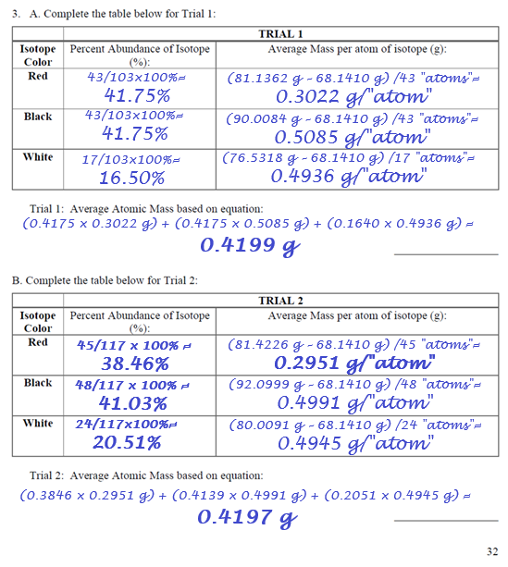
Example Data Analysis

Slide 12
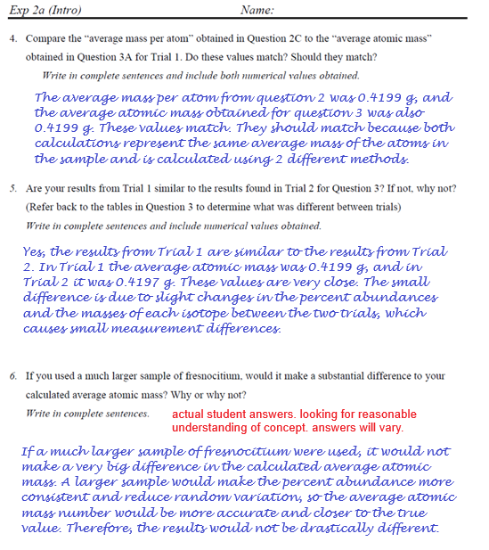
Example Data Analysis

